Slide 1


Capstone Project: Business Intelligence Solution for HCA Healthcare
Rachael Herman
Colorado State University Global
MIS480: Business Analytics and Information Systems
Professor Justin Bateh
October 9, 2022
Notes:
Hi, and welcome to my final capstone project. In this presentation, I'll be reviewing a business intelligence solution for a U.S.-based organization, where a business problem is identified, researched, and analyzed using a public data set.

Slide 2
Introduction
HCA Healthcare
Data set used
BI tools utilized
Code and functions for statistical analysis
Interpretation of statistical results
Visualizations and interpretations
Notes:
The organization of focus for this project is HCA Healthcare. The research focuses on publicly available data from the Center for Medicare and Medicaid Services.
The data analyzes overall patient satisfaction in the U.S. and compares the national average for important topics like mortality rates, readmissions, and overall patient experience.
The goal is to identify areas where HCA can focus resources to gain more insight into patient experience within its own facilities.
This presentation describes the business problem, the public data set used, the business intelligence tools utilized, the code performed for statistical analysis, data visualizations and interpretations, and recommendations for how HCA Healthcare can use the information.

Slide 3
HCA Healthcare Background & Rationale
HCA Healthcare, services provider, Based in Nashville, TN (Our history, n.d.)
186 hospitals and 2,000+ ambulatory sites of care (Who we are, n.d.)
Chosen for size, for-profit status, and healthcare background
Uses data to develop tech and best practices that improve patient care (Wo we are, n.d.)
Notes:
While HCA Healthcare has a few locations in the U.K., they are primarily in the United States, with headquarters in Nashville, TN.
They have 186 hospitals plus more than 2000 ambulatory care sites around the country.
HCA Healthcare was chosen for its size and for-profit status and because of my background in healthcare as a medical transcriptionist and then content marketer for small medical offices. Further, a HIPAA privacy and security certification offers me a rich understanding of the data in this industry.

Slide 4

Business Problem Addressed
Patient satisfaction directly related to revenue, with positive experiences linked to increased profitability (Richter & Muhlestein, 2017).
Many variables determine patient satisfaction.
CMS focuses on where patients are satisfied and not
Topics include things like communication, staff friendliness, and care transitions.
Public data will help HCA find where to focus internal surveys to identify areas of improvement.
Notes:
Patient satisfaction is the extent to which patients and their caregivers are happy with the care they receive.
Patient experience is directly related to revenue, with positive experiences linked to greater profitability (Richter & Muhlestein, 20017).
Survey data from CMS focuses on where patients are most and least satisfied in similar facilities to HCA. The data looks at how patients rate topics like noise, doctor communication, care transitions, and facility cleanliness.
As HCA doesn’t have any public data sets available, the CMS data can help the organization formulate an internal patient survey and aggregate public reviews to identify areas for improvement at its facilities.
That internal data can then be compared to the national data presented here.

Slide 5

Data Set Used and Where to Access
CMS hospitals data archive
US patient satisfaction survey data from 2016-2020 (PQDC, n.d.).
5 CSV files included
Data can be accessed and downloaded from the CMS website.
Merged data stored in Power BI, GitHub, and Google Drive
Notes:
The specific data sets chosen for analysis came from CMS hospitals data archive. It includes U.S. patient satisfaction survey data in five CSV files from 2016 to 2020 (PQDC, n.d.). This data is readily available from the CMS website.
The five files were combined into a single, merged file, which is stored in Power B.I., GitHub, and Google Drive.

Slide 6
Tools Used
Power Query in Excel for Data Cleansing reduced variables from 43 to 20 and observations from 2M+ to 132,174
RStudio for Statistical Analysis
Microsoft Power BI for Data Visualization
Notes:
Data cleansing was necessary for this project, given the number of files and observations. When merged, the file contained over 2 million observations and 43 variables.
But many variables were deemed unnecessary, such as facility code or phone number, and many rows had missing data. Therefore, the files were loaded, merged, and transformed in Power Query using Excel.
With data cleansing, I reduced the number of variables to 20 and observations to just over 132,000—a much more workable set.
R is an open-source programming language and statistical analysis tool that offers significant insight into qualitative and quantitative data. RStudio is the IDE, or integrated development environment, for R and was used for this analysis.
Microsoft Power B.I. is a robust visualization tool that is good for analysis and creating dynamic dashboards. Power B.I. helped translate the statistical data into a visual, interactive dashboard, which we’ll see in just a few slides.

Slide 7

Code and Functions
The str() function gives a good view of data types
The topic was converted to a factor using mutate(), and ratings summarized with filter(), group_by(), and summarise() functions. Ungroup() used to make sure the grouping doesn’t affect the rest of the analysis.
Scatter plot uses ggplot(), geom_point(), geom_abline() and theme().
The lm() function is for linear regression to identify important predictors/coefficients
The table() functions provide a contingency table to ensure there were plenty of surveys to review in proprietary facilities
Notes:
Several packages were installed in RStudio for computations and modeling. The structure function helped me determine if I was working with the right data types.
The information revealed that the Topic variable needed to be converted to a factor for graphical analysis. This was done using piping and the mutate function.
An object for hospital_data_summarise was created using the original data frame that stored the imported file. This object used filter, group_by, and summarize functions to get the means of hospital and patient ratings at proprietary facilities, separated by topic. The ungroup function ensured this grouping wouldn't affect the rest of the analysis.
A simple scatter plot to look at the average patient ratings per topic was created using the ggplot, geom_point, geom_abline, and theme functions.
The linear regression model uses the lm() function and helped find significant coefficients for the patient and hospital ratings based on topics.
Unfortunately, a linear regression model to look at all variables for hospital and patient ratings was too big of a task for Rstudio and could not be done in this analysis. Therefore, just the topics were used as a focus for predictors or coefficients.
A contingency table was created using the table() function and provided a clear look at the number of reviews (1 through 5) for each topic at proprietary facilities. This helped ensure I had an adequate sample in those for-profit facilities.

Slide 8

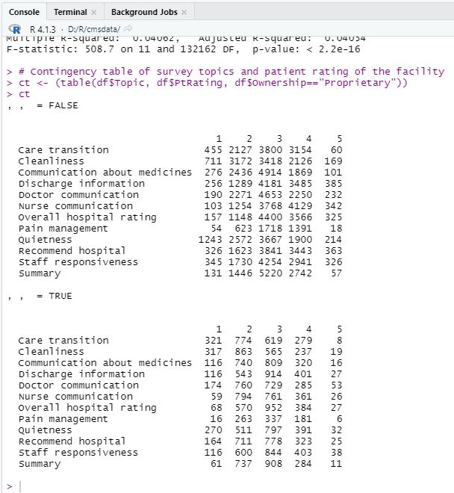
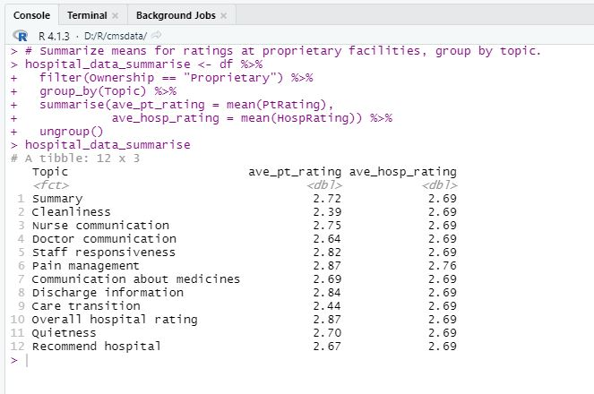
Summarized Averages and Contingency Table
Notes:
The contingency tables in the left image show the most frequent reviews for each rating and topic. There are two tables here — the top table is for all facilities except proprietary, and the bottom table is for proprietary facilities only.
Most patients tend to rate topics between a 2 and 3 at proprietary facilities.
Interestingly, we can see in the top contingency table that patients tend to rate the topics a bit higher at 3 or 4. This may be the result of more reviews, though.
The summarized averages in the right image show relatively uniform values for hospital ratings at proprietary hospitals over the five years. However, the table does show some variation in patient ratings for each topic.
This tells me that average overall hospital ratings won't be much use in this analysis. The patient ratings have more variability and are more important for this study in terms of patient satisfaction anyway, so they'll be the focus of this analysis.

Slide 9
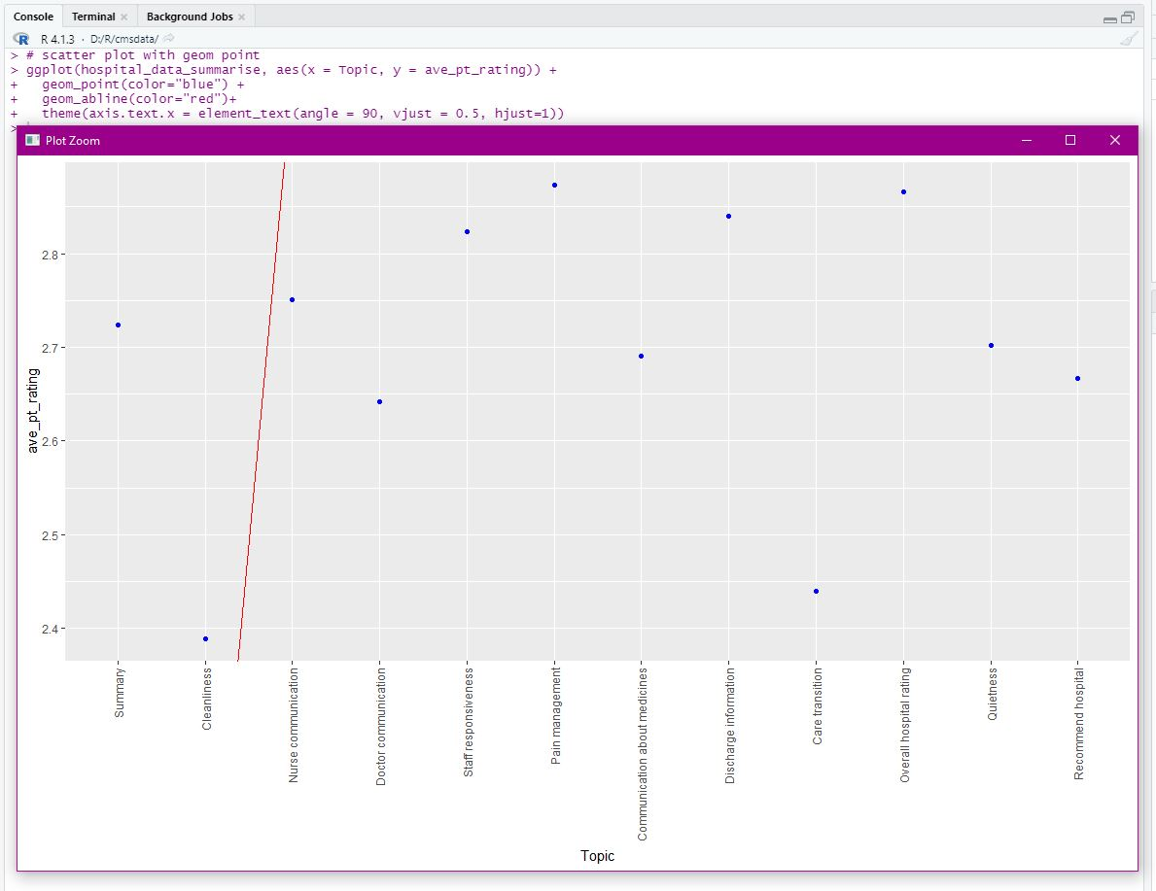
Scatter Plot of Patient Ratings by Topic
Notes:
A scatter plot is used to get a better look at the patient ratings by topic. We can see a weak scattering of ratings per topic and a drastic regression line, indicating a weak correlation. This result is also demonstrated in the linear regression models, which we'll look at next.

Slide 10
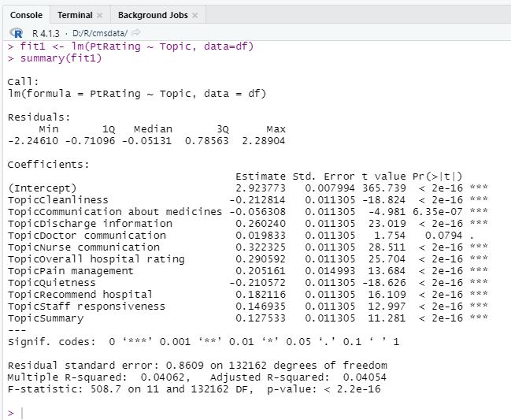
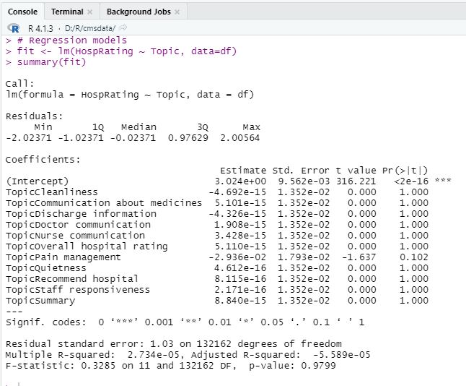
Linear Regression as Predicted by Topic
Notes:
These two regression models indicate that hospital ratings are not affected by topics, but patient ratings are. We can see this by the p values being 1 and t values being 0 in the right table, while p values are very low and t values higher in the left table.
The R-squared and adjusted R-squared values are low, indicating weak predictors (Frost, 2017). However, the higher t-values and F-statistic in the model for patient ratings on the left indicate a good fit model with higher confidence.
Given the uniformity and insignificant topic coefficients for overall hospital ratings — and since patients review the overall hospital in the survey topics — hospital ratings as a variable were not the center of evaluation for this analysis. Instead, the patient ratings were used to determine where HCA can focus attention to improve patient experience.

Slide 11
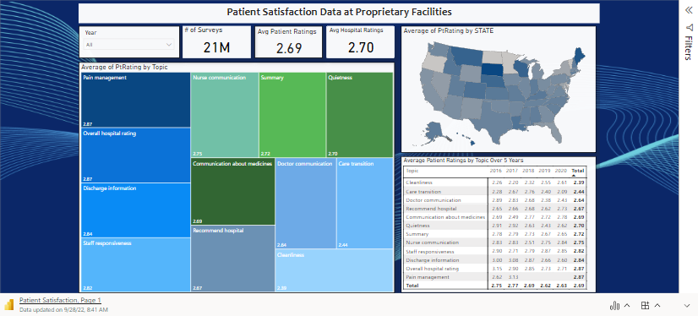
Interactive Dashboard – Power BI
Notes:
One of the reasons I chose Power BI is because of its interactive reports and dashboard capabilities.
With a free account, you can gain access to this report through this presentation. It's easy to use and contains just a few simple graphics to help users better understand the most important topics at proprietary facilities over the five-year period. Interactive dashboards help managers and users better measure KPIs (Laursen and Thorlund, 2016).
In this report, users can drill down by year, topic, and state. The state map is useful for looking at HCA facilities in the lowest or highest rating states. States with the lowest ratings could be the focus of HCA surveys to see where their facilities stand against the national averages of other proprietary facilities.
Let’s take a quick look at this data.

Slide 12
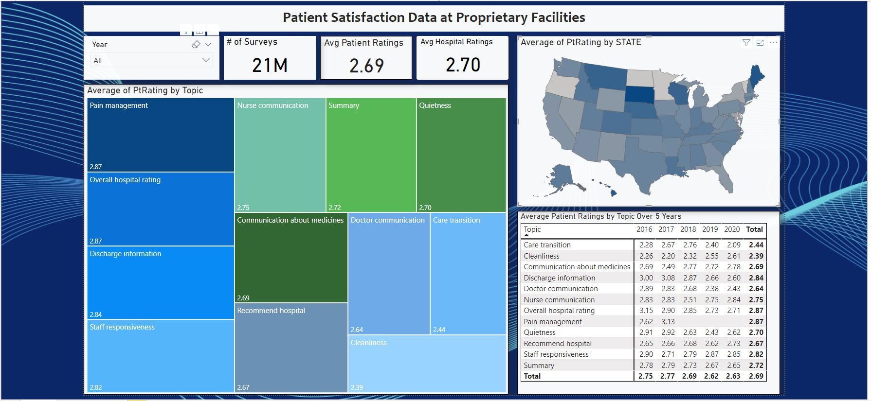
Data Visualization Interpretations and Recommendations
Patient ratings show averages 2 to 3 for all topics at proprietary facilities. Higher in all others.
States indicate where patients are most and least satisfied.
HCA Healthcare can use this BI solution to develop an internal survey focusing on topics where patients are rating the lowest scores in states where HCA has locations.
HCA can aggregate public review data for facilities in specific regions where they survey and find areas of improvement.
Notes:
A lot of interesting information can be gleaned from this data, especially with the drill-down abilities in the dashboard.
I focused on patient ratings for topics across 5 years of surveys and included the states to dig deeper into the data. This is especially important for a nationwide organization like HCA, with locations across the country.
HCA can use this information to create its own internal survey, targeting specific topics in the lowest-rating states where they have locations. Then, they can aggregate public review data for those regional facilities and compare them to internal and national survey data for greater insights into patient satisfaction and experience.

Slide 13


Challenges and Limitations
National survey data was a large set and required extensive cleaning
Determining which tools would best suit the project was difficult. Learning curves were considered.
The set is too large to run a linear regression model on ratings using all variables
Data does not include ambulatory facilities, hospital size, or revenue information
Notes:
There were a few challenges in the project and limitations in the data that should be recognized.
First, the biggest challenge was in merging and cleaning the data. This took quite a few hours. Getting it down to 20 variables from 43 and about 132,000 observations from over 2 million was a good result that led to reliable analysis.
Another challenge was in deciding which B.I. tools to use. In one of the milestones, I had chosen Tableau for visualization and SAS for statistical analysis, but these programs proved very difficult to use with too steep of a learning curve. Microsoft Power B.I. was used in place of Tableau. It also offered an interactive option for this presentation, which I found compelling.
RStudio was used in place of SAS. We've been using this software throughout most of the program, making statistical analysis much more manageable.
Some limitations to the analysis are that the data set did not include the size of the hospitals, ambulatory care facilities, or revenue information to compare to HCA's business profile. However, given the goal was to identify topics of concern to patients around the country, this data proved useful.
Another limitation was in running linear regressions. It was difficult to determine significant predictors or coefficients for hospital ratings because of the size of the data set. However, given the hospital ratings were not influenced by the topic, I felt it was safe to remove them from most of the analysis and interpretation. I was primarily focused on patient ratings regarding the hospitals. Also, one of the survey topics was "overall hospital rating," so I was comfortable excluding the hospital ratings variable from most of this analysis.

Slide 14
Summary
HCA Healthcare is a large U.S. based organization with hundreds of hospitals and thousands of ambulatory care facilities nationwide.
They focus heavily on improving patient care by analyzing data from millions of visits.
The BI solution presented here offers insight into patient ratings for specific topics at similar hospitals around the country.
HCA can use this data to develop internal surveys for low-rating topics in low-rating states where they have locations and combine this data with aggregated public review data to gain deeper insights and find areas for improvement.
Notes:
HCA Healthcare is a prominent U.S.-based organization with hundreds of hospitals and thousands of ambulatory facilities around the country. They focus on evaluating data to improve patient experience and develop new technologies for best practices and patient care.
Their business intelligence solution here centers around patient experience through survey data of nationwide proprietary (for-profit) facilities. The patient's ratings on specific topics are critical to understanding where facilities should focus their resources for improvement.
The topics of an HCA survey should be heavily focused on cleanliness, doctor communication, and care transitions, as those were the lowest ratings in other facilities. However, that doesn’t mean they should ignore the other topics. Instead, HCA Healthcare could tailor an internal survey using all topics and target states with the lowest ratings to compare that with national data and their internal reviews to get the best insights.

Slide 15

Thank You for the Experience
Notes:
This project has been both challenging and rewarding. I learned a great deal not only about patient satisfaction but about the business intelligence tools.
Thanks for your time and guidance throughout this term. Please let me know if there are any questions regarding this presentation, the Power BI report, or the related essay.

Slide 16
References
Frost, J. (2017, April 16). How to interpret R-squared in regression analysis. Statistics by Jim. Retrieved September 27, 2022, from https://statisticsbyjim.com/regression/interpret-r-squared-regression/
Laursen, G.H. N., & Thorlund, J. (2016). Business analytics for managers: Taking business intelligence beyond reporting (2nd ed.). Wiley Professional Development (P&T). https://mbsdirect.vitalsource.com/books/9781119302537
Our history. (n.d.). HCA Healthcare. Retrieved September 17, 2022, from https://hcahealthcare.com/about/our-history.dot
PQDC. (n.d.). Retrieved September 8, 2022, from https://data.cms.gov/provider-data/archived-data/hospitals
Richter, J.P. & Muhlestein, D.B. (2017). Patient experience and hospital profitability: Is there a link? Health Care Management Review, 42(3), 247-257. doi: 10.1097/HMR.0000000000000105
Who we are. (n.d.) HCA Healthcare. https://hcahealthcare.com/about

